Slide 1
Visualization with R, RStudio and RMarkdown
Genomic Data Visualization & Integration
HUGEN 2073
(Slides adapted from Ryan Minster with permission)

Slide 2
Learning Objectives
By the end of the session, students will be able to:
Create and manipulate objects and vectors in R
Manipulate data frames in R
Create very basic plots in R

Slide 3
ACHTUNG!
I have tried to catch Microsoft autocorrects but may have missed some.
Beware the difference between ", “, and ”.
Beware the difference between ', ‘, ’, and `.
Beware the difference between -, –, and — (a hyphen, an en dash and an em dash, respectively). Also - vs --. Also = vs ==.
Double check capitalization.
Beware the difference between O, o and 0, and between 1, I and l.

Slide 4
Software
​R is a programming language and free software environment for statistical computing and graphics supported by the R Foundation for Statistical Computing.
​RStudio is an integrated development environment (IDE) for R.
​RMarkdown is a package for processing markup documents in Rstudio that weave together narrative text and (usually) R code into formatted output in HTML, PDFs, MS Word etc.

Slide 5
R
R is a programming language and free software environment for statistical computing and graphics supported by the R Foundation for Statistical Computing.
It is widely used by statisticans and data miners, and especially among academics (see free above).

Slide 6
R
R performs mathematical calculations > 1 + 2 # comments can be added after hashes [1] 3
Often these calculations are in the form of functions. > sqrt(4)
[1] 2
> mean(c(1,2,3,4)) [1] 2.5 > rnorm(n = 2, mean = 0, sd = 1) [1] -0.4171808 -0.2499255
> rnorm(2, 0, 1) [1] -0.06301373 -0.97962780

Slide 7
R
Functions can be nested inside of other functions. > rnorm(n = sqrt(mean(c(2,4,6))), mean = 1 - 1, sd = 1) [1] -0.4171808 -0.2499255

Slide 8
R
To get documentation about a function use ?. > ?rnorm
To search documentation use ??. > ??normal

Slide 9
R
It can save information into objects (which are like variables) > a <- 1 > a [1] 1 > a <- 1 + 2 > a
[1] 3 > beta <- 2 + 2 > beta [1] 4 > a + beta [1] 7

Slide 10
R
These objects can be vectors of values > a <- c(1, 2, 3, 4) > a [1] 1 2 3 4 > a <- c(TRUE, FALSE, FALSE, FALSE, FALSE, TRUE, FALSE) > a
[1] TRUE FALSE FALSE FALSE FALSE TRUE FALSE

Slide 11
R
You can choose subsets of values in a vector > a <- c("a", "b", "c", "d") > a [1] "a" "b" "c" "d" > a[2] [1] "b" > a[2:3] [1] "b" "c" > a[2] <- "z" > a [1] "a" "z" "c" "d"

Slide 12
R
You can operate on subsets of values in a vector > a <- c(1, 2, 3, 4) > a [1] 1 2 3 4 > a[c(2,4)] <- a[c(2,4)] + c(0.3, 0.5) > a [1] 1 2.3 3 4.5

Slide 13
R
Using conditions and TRUE and FALSE can be handy > a <- c(1, 2, 3, 4) > a == 2 [1] FALSE TRUE FALSE FALSE > a[a == 2] [1] 2 > a[c(FALSE, TRUE, FALSE, FALSE)] [1] 2

Slide 14
R
R can work with tables of data called data frames. > a <- read.csv("data3.csv") # read in CSV data from file > a name x y 1 Anna 1.1 0.50 2 Xiao 1.9 0.75 3 José 3.0 0.80

Slide 15
R
Since data frames are two dimensional, to subset you need two coordinates: > a name x y 1 Anna 1.1 0.50 2 Xiao 1.9 0.75 3 José 3.0 0.80 > a[2, 3] [1] 0.75 > a[3, 1] [1] "José"

Slide 16
R
If you leave one of the two coordinates empty, you’ll get a vector: > a name x y 1 Anna 1.1 0.50 2 Xiao 1.9 0.75 3 José 3.0 0.80 > a[2, ] name x y 2 Xiao 1.9 0.75 > a[, 1] [1] "Anna" "Xiao" "José"

Slide 17
R
You can use conditions and functions within the [s and ]s too. > a name x y 1 Anna 1.1 0.50 2 Xiao 1.9 0.75 3 José 3.0 0.80 > a[a[, 1] == "Xiao", c("x")] [1] 1.9

Slide 18
R
We often work with a whole column at a time, and there is a shortcut for that using $. > a name x y 1 Anna 1.1 0.50 2 Xiao 1.9 0.75 3 José 3.0 0.80 > a$name [1] "Anna" "Xiao" "José” >

Slide 19
R
Note these three are exactly equal: > identical(a$name, a[, 1]) [1] TRUE > identical(a$name, a[, c("name")]) [1] TRUE > identical(a[, 1], a[, c("name")]) [1] TRUE

Slide 20
R
R can also manipulate tables of data by adding columns that are transformations of other columns: > a$z <- a$x + a$y > a name x y z 1 Anna 1.1 0.50 1.60 2 Xiao 1.9 0.75 2.65 3 José 3.0 0.80 3.80

Slide 21
R
R can also manipulate tables of data by adding columns that are transformations of other columns: > a$b <- sqrt(a$z) > a name x y z b 1 Anna 1.1 0.50 1.60 1.264911 2 Xiao 1.9 0.75 2.65 1.627882 3 José 3.0 0.80 3.80 1.949359

Slide 22
R
You can also add new data to a data frame. > a$r <- runif(length(a$z)) > a name x y z r 1 Anna 1.1 0.50 1.60 0.38347170 2 Xiao 1.9 0.75 2.65 0.55333872 3 José 3.0 0.80 3.80 0.04019723 > > write.csv(a, "newdata.csv") # write object a to CSV file

Slide 23
R
​Reading and writing CSV data into and out of R > a <- read.csv("data3.csv") > a name x y z r 1 Anna 1.1 0.50 1.60 0.38347170 2 Xiao 1.9 0.75 2.65 0.55333872 3 José 3.0 0.80 3.80 0.04019723 > > write.csv(a, "newdata.csv")

Slide 24
R
R can also create graphics. > plot(a$x, a$y) > a[, c("x", "y")] x y 1 1.1 0.50 2 1.9 0.75 3 3.0 0.80

Slide 25
R
R can also create graphics. > plot(a$x, a$y, type = "o") > a[, c("x", "y")] x y 1 1.1 0.50 2 1.9 0.75 3 3.0 0.80

Slide 26
R
R can also create graphics. > barplot(a$z, horiz = TRUE, names.arg=a$name) > a[, c("name", "z")] name z 1 Anna 1.60 2 Xiao 2.65 3 José 3.80

Slide 27
R
R’s basic capabilities can be extended by writing additional functions that can be make available publicly through packages.
A major extension of R’s basic graphics uses a package called ggplot2

Slide 28
RStudio
RStudio is an integrated development environment (IDE) for R.

Slide 29
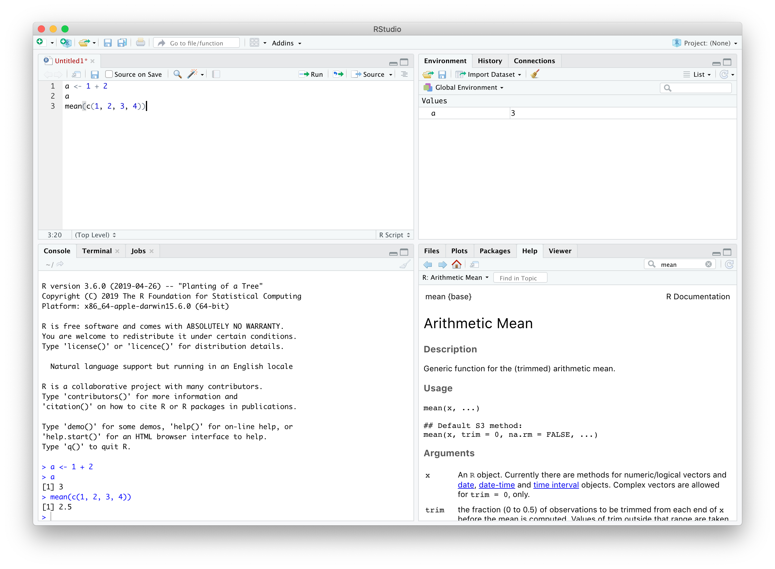

Slide 30
RMarkdown
RMarkdown is a package for processing markup documents in RStudio that weave together narrative text and (usually) R code into formatted output in HTML, PDFs, MS Word etc.
Markup documents are data files that are primarily geared toward telling a browser (or other type of program) how to display a document:
Make this a header, make that italics etc.
RMarkdown has the bonus of being able to incorporate statistical programming code right into the narrative document itself.

Slide 31
Basic RMarkdown File
--- title: "Plots for 2073" output:html_document --- ## Squares Here is a plot of numbers and their squares. ```{r} x <- c(1,2,3,4,5,6,7,8,9,10) y <- x^2 plot(x, y) ```

Slide 32
Basic RMarkdown Formatting
Make a header: ## Header
Make text bold: **This text will be bold.**
Make text italics: *This text will be italic.*

Slide 33
Basic RMarkdown Code Chunks
To add some R code (this is called a chunk): ```{r} 1 + 2 x <- c(1,2,3,4) y <- mean(x) ```
To add some R embedded in the narrative text itself (inline): The mean of the `r length(c(1,2,3,4))` values is `r x`.

Slide 34
Cool RMarkdown Stuff
Add a floating table of contents: output: html_document: toc: true toc_float: true
Add code folding: output: html_document: toc: true toc_float: true code_folding: hide

Slide 35
Cool RMarkdown Stuff
Make a pretty table: library(knitr) kable(a)
RMarkdown Cookbook: https://bookdown.org/yihui/rmarkdown-cookbook/

Slide 36
R Graphics
R’s graphing capabilities are prodigious and (can be) astonishing, vibrant and useful.
Google: fancy r plots

Slide 37
R Graphics
Two of the graphics systems in R are base graphics and ggplot2 graphics, which have different vocabularies for rendering plots.
​Base graphics are your factory default R functions
They can produce beautiful graphics
Interaction is initially more intuitive than ggplot2
Sophisticated changes from the default settings can be a pain to program
​ggplot2 graphics are an upgrade
They can produce beautiful graphics
Interaction is initially less intuitive than base graphics
Sophisticated changes from the default settings are easier to program

Slide 38
Base Graphics
​plot() · scatter plots
​boxplot() · box plots
​hist() · histograms
​barplot() · bar plots

Slide 39
Base Graphics
Common arguments of plotting commands
​x = <VECTOR1>, y = <VECTOR2> · the data to be plotted
​main = · plot title
​xlab = · x axis label
​ylab = · y axis label
​xlim = · range of x axis (vector of length 2)
​ylim = · range of y axis (vector of length 2)

Slide 40
Base Graphics
So plotting numbers and their squares: > x <- c(1,2,3,4,5,6,7,8,9,10) > y <- x^2 > plot(x, y) > plot(x, y, main = "Squares", xlab = "Integers", ylab = "Squares", xlim = c(-10, 110), ylim = c(-10, 100))

Slide 41
Base Graphics
Common arguments of plotting commands
These can vectorized (different attributes for different points)
​cex = · size of data points
​col = · color
​pch = · plotting symbols
​lty = · line type
​lwd = · line width (also applies to outline of data points)

Slide 42
lty Values
You can use numbers or character strings
​0 or "blank" · no line
​1 or "solid" · default
​2 or "dashed" or "44" · dashed line
​3 or "dotted" or "13" · dotted line
​4 or "dotdash" or "1343" · dot dash dot dash line
​5 or "longdash" or "73" · dashes are longer
​6 or "twodash" or "2262" · short long short long dashes

Slide 43

pch Values
You can use numbers or character strings
​Numbers:
Characters · Display the character itself as the point
The inner color can be set for 21–25
Here the outline color is white and the inner color is yellow

Slide 44
col Values
R has eight basic colors
​1 · black .
​2 · red .
​3 · green .
​4 · blue .
​5 · cyan .
​6 · magenta .
​7 · yellow .
​8 · gray .

Slide 45
col Values
R has much more available in terms of color using predefined palettes and encoding using RGB, CMYK, and HSB systems (for example).

Slide 46
Base Graphics
So, plotting numbers and their squares: > x <- c(1,2,3,4,5,6,7,8,9,10) > y <- x^2 > plot(x, y) > plot(x, y, main = "Squares", xlab = "Integers", ylab = "Squares", xlim = c(-10, 110), ylim = c(-10, 100), pch = c(15,16,17), col = c(2,3,4), cex = 3, lwd = 2)

Slide 47
Base Graphics
Common commands for adding to an existing plot:
​abline() · adds a straight line
​legend() · adds a legend
​points() · adds additional points to a plot (like a second series)
​lines() · adds a line series to a plot

Slide 48
Base Graphics
Let’s add a line between the points: > lines(x, y, col = 1, lwd = 4, lty = "dotted")
Let’s also add a vertical line at 9 and a horizontal line at 81: > abline(v = 9, lwd = 4, col = 2) > abline(h = 81, lwd = 4, col = 4)
Let’s finally add a second set of points: > y2 <- x * 9 > points(x, y2, col = 1, lwd = 4, cex = 2)

Slide 49
Visualization with R: Example with R Base Graphics
Genomic Data Visualization & Integration
HUGEN 2073
(Slides adapted from Ryan Minster with permission)

Slide 50
Learning Objectives
By the end of the session, students will be able to:
Create a scatterplot with two categories of data points using R base graphics

Slide 51
Create a Scatterplot in R Base Graphics
Steps
Read the data into R
Execute the optical method of analysis to review the data
Plot a scatterplot of height vs age
Plot a scatterplot of height vs age stratified by sex

Slide 52
Read in the Data
data <- read.csv("20220120-rlm-2073_Data.csv")

Slide 53
Optical Method
LOOK! AT! THE! DATA!
How many rows and columns are there? dim(data)
What are the values in the data? head(data) tail(data) summary(data)

Slide 54
Optical Method cont’d
“table()” categorical data table(data$sex)
Look at basic histograms of continuous data using hist() hist(data$age) hist(data$height)
Play around with breaks to see different shapes of the histograms hist(data$height, breaks = 10) hist(data$height, breaks = 100) hist(data$height, breaks = 1000)

Slide 55
Create a Scatterplot using plot()
If we are plotting height vs age
That is, by convention, dependent vs independent variable, or
​y vs x
So, y = height and x = age plot(x = data$age, y = data$height) or plot(data$age, data$height

Slide 56
Create a Scatterplot using plot()
Change points shape and color plot(data$age, data$height, pch = 16, col = alpha("black", 0.25))
​alpha() is a function that lets you add transparency to a color, such that 0.25 means 25% opaque and 75% transparent.

Slide 57
Stratify Scatterplot by Category
If we are plotting height vs age by sex, we can
Plot female and male participants separately
Plot female and male participants together using color, shape, or both to distinguish them

Slide 58
Stratify Scatterplot by Category Separately
Plotting separately plot(data$age[data$sex == "F"], data$height[data$sex == "F"], pch = 17, col = alpha("darkgreen", 0.25)) plot(data$age[data$sex == "M"], data$height[data$sex == "M"], pch = 16, col = alpha("purple", 0.25))

Slide 59
Stratify Scatterplot by Category Separately
But the y axis scales are different, so difficult to compare! Here, the x axis scales happen to match, but they could be different too. summary(data$height) Min. 1st Qu. Median Mean 3rd Qu. Max. 143.0 164.0 171.0 171.6 179.0 204.0 plot(data$age[data$sex == "F"], data$height[data$sex == "F"], pch = 17, col = alpha("darkgreen", 0.25), ylim = c(143, 204)) plot(data$age[data$sex == "M"], data$height[data$sex == "M"], pch = 16, col = alpha("purple", 0.25), ylim = c(143, 204))

Slide 60
Stratify Scatterplot by Category Together
Plotting together, I have two approaches to choose from:
Plot female participants first, then overlay male participants
Plot simultaneously, supplying pch and col with vectors that correspond to how each data point will be displayed

Slide 61
Stratify Scatterplot by Category Overlay
Plotting one then the other plot(data$age[data$sex == "F"], data$height[data$sex == "F"], pch = 17, col = alpha("darkgreen", 0.25)) points(data$age[data$sex == "M"], data$height[data$sex == "M"], pch = 16, col = alpha("purple", 0.25))

Slide 62
Stratify Scatterplot by Category Overlay
But the y axis scales was based on the female participants, so data points for tallest male participants are off the plot! Again, the x axis scales happen to work, but the same issue could occur. summary(data$height) Min. 1st Qu. Median Mean 3rd Qu. Max. 143.0 164.0 171.0 171.6 179.0 204.0 plot(data$age[data$sex == "F"], data$height[data$sex == "F"], pch = 17, col = alpha("darkgreen", 0.25), ylim = c(143, 204)) points(data$age[data$sex == "M"], data$height[data$sex == "M"], pch = 16, col = alpha("purple", 0.25))

Slide 63
Stratify Scatterplot by Category Simultaneous
Plotting simultaneously
First create vectors holding what will be given to pch and col. data$pch[data$sex == "F"] <- 17 data$pch[data$sex == "M"] <- 16 data$col[data$sex == "F"] <- "darkgreen" data$col[data$sex == "M"] <- "purple"
Check out the data to see if it looks right LOOK! AT! THE! DATA! head(data) table(data$sex, data$pch) table(data$sex, data$col)

Slide 64
Stratify Scatterplot by Category Simultaneous
Plotting simultaneously
Second provide those vectors to pch and col in plot(). plot(data$age, data$height, pch = data$pch, col = alpha(data$col, 0.25))
Note that you had to do more to set up the data, but less in the actual plotting code itself. No checking axes limits or additional functions to overlay additional points.

Slide 65
Final Notes
Of course, final plots would include better axis labels, a title, and a legend, at the least.
Additionally, beware using shapes and colors that code for male and female in ways that align with and perpetuate sexist stereotypes of masculinity and femininity.
Such encodings can be culture-specific.
Often in American culture, pink and round ( ) is female and blue and angular ( ) is male. Avoid such mappings.

